Slide 1
BSP2 – Week 2 presentation
Parameters and actions of OpenAi’s Pong
Environment and setup of OpenAi’s Pong

Slide 2
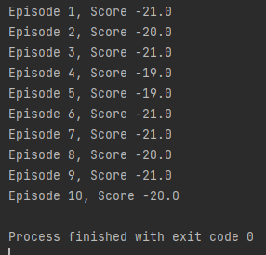
What are the actions and parameters of the game?
Action Space:
There are five actions currently available:
  0: NOOP (No operation) -> The agent does nothing
  1: FIRE -> Used as generic action, but has no meaning in pong
  2: RIGHT -> The paddle is moved to the right
  3: LEFT -> The paddle is moved to the left
  4: RIGHTFIRE -> Placeholder for generic action, no meaning in pong
  5: LEFTFIRE -> Placeholder for generic action, no meaning in pong
For our pong game, we will on only be using LEFT and RIGHT. The AI should therefore only have access to these two controls
Observation Space: Height: 210 pixels, Width: 160 pixels
State: Includes information about the game’s internal variables
Reward: In Pong’s case, the score
“Done”: Boolean variable which indicates whether the game is done
Render_mode = “human” displays game visually; “rgb_array” captures frames programmatically ->

Slide 3
What are the actions and parameters of the game?
Frameskip: determines how many frames are skipped between agent actions
Max_episode_length: Number of frames allowed in an episode

Slide 4
Retrieving information from the game
OpenAi’s Gym Pong does not give access to internal variables such as paddle position, ball position, etc..
This is problematic for creating a reinforcement learning AI
Solutions:
  1: Create own environment where we can monitor these variables and use them in “state” to determine “action” of the AI
  2: Use frame_analysis techniques to analyse OpenAi’s Gym-Pong. This has been done before and there is documentation on way’s to do this
    The “preprocessing frames” & “supplying directional information” section of this article documents one way to retrieve data from OpenAi’s Pong game link

Slide 5
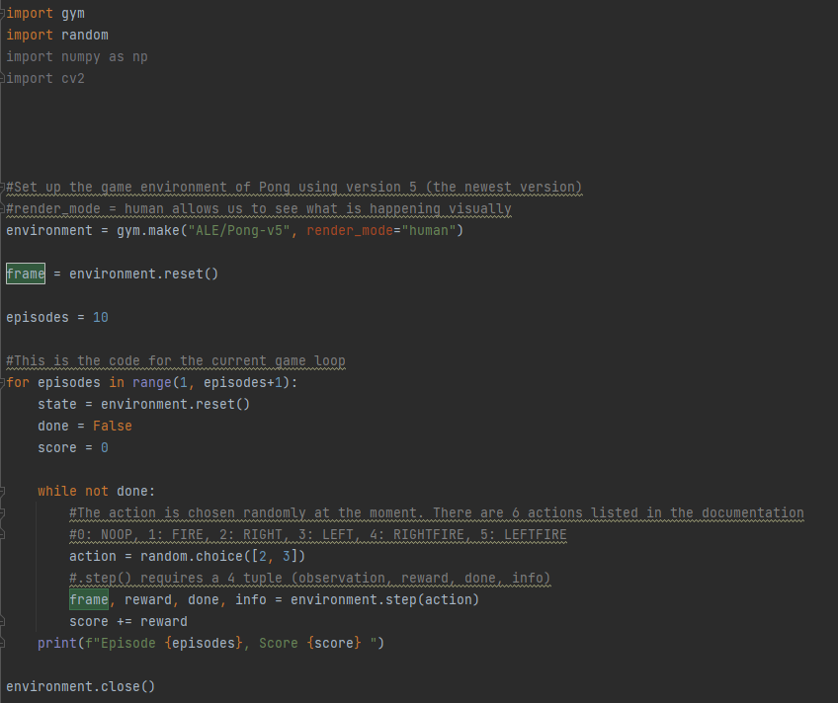
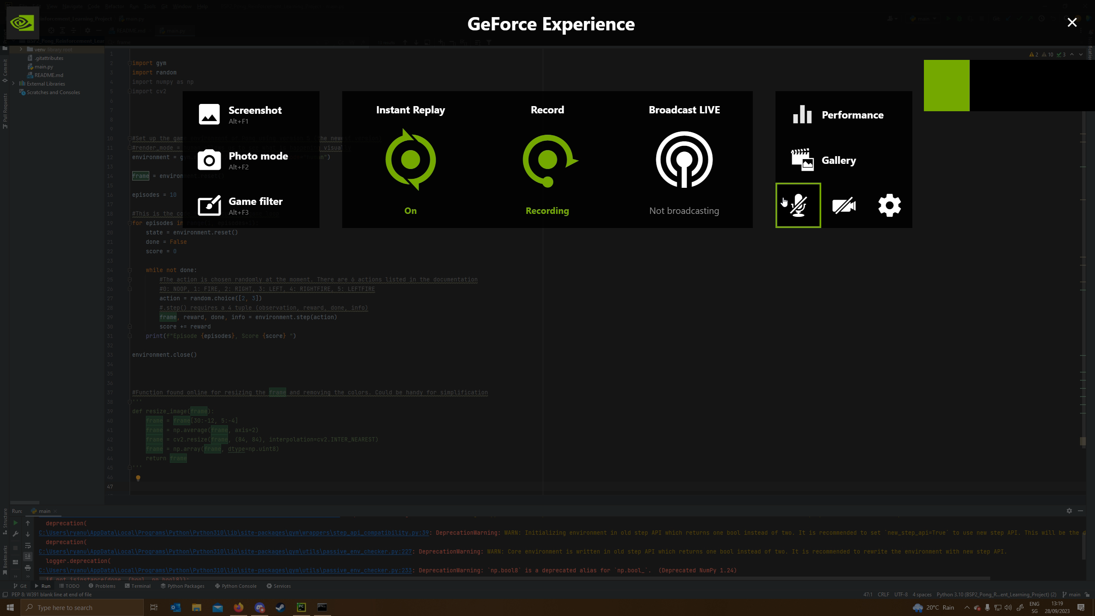
Game environment setup
Current code for setting up the game environment. Right now, random actions are taken by the program
For frame analysis, the colors of the paddles (green and red) and the colour of the ball could be used (white)

Slide 6
Setting up the agent
The agent should have a set of possible actions (LEFT, RIGHT)
Neural network architecture which takes in inputs from the game
A reinforcement learning algorithm
Very basic visualization of the neural network for our agent:
Ball location
Hidden layers
1 – x %
LEFT
Player Paddle location
With x + y = 1
1 – y%
Paddle 2 location (maybe not needed)
RIGHT

